Slide 1
Academic Writing in the Engineering Studies
University of Agder
Faculty of Science and Technology
Gunvor Sofia Almlie, Assistant Professor
VIRAK Stavanger, 14. June 2019

Slide 2
Background
Problem: Engineering students’ problems in writing academic texts
Solution: Disciplinary ‘crash courses’ in academic writing
Evaluation: A survey

Slide 3
Objective of the Study
Academic writing in the professional studies: How to better prepare students for academic writing
Students’ perception of course design and supervision in academic writing
Improving course design accordingly
Contributions to the general discourse on academic writing at university level

Slide 4
Course Description
Integrated in Introductory Course for Engineering 5 sp
Lectures over three weeks (4 lessons of total 44)
Library staff lectured on sources and referencing style (2 lessons)
Supervision 2 lessons a week during semester
The use of the library’s writing shed ‘skrivestua’ for supervision
Discipline- and task-related instruction

Slide 5
Method
Survey
Some items borrowed from Monash University (Dawson et al, 2018)
Autumn 2018
Distributed online
Maximum response rate 41%
Minimum response rate 26%

Slide 6
Overview of Reported Data
Data findings are grouped into three categories
Students’ perception of lectures
Supervision and feedback
Students’ perceived challenges

Slide 7
Students’ Perception of Lectures
78% find lectures in academic writing useful
88% are satisfied with lectures in academic writing

Slide 8
Supervision and Feedback: Satisfaction
97% are satisfied with supervision and feedback

Slide 9
Supervision and Feedback

Slide 10
Supervision and Feedback: Who provided you with comments on your assignment?
n | Before submission | After submission
Lecturer/disciplinary supervisor | 58 | 23
Library supervisor | 17 | 2
Peers | 59 | 12
Friends | 26 | 5

Slide 11
How do students prefer to receive feedback on assignments?

Slide 12
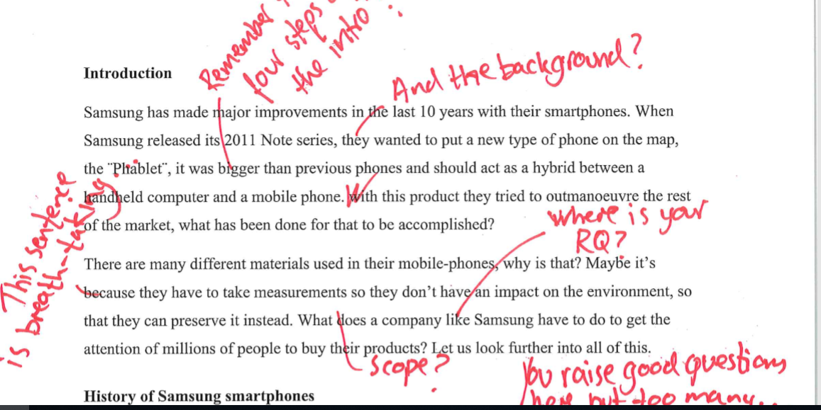

Slide 13
Comments on supervision and feedback

Slide 14
Summary: The Role of Feedback and Supervision
Supervision and feedback help achieve learning outcomes
Supervision motivates
Electronic and face-to-face feedback preferred
Detailed and personalised supervision preferred

Slide 15

What do students find difficult in academic writing?

Slide 16
What do students find difficult in academic writing?
 | Not challenging | Somewhat challenging | Very challenging
Finding relevant sources | 25% | 58% | 17%
Creating a thesis statement | 13% | 61% | 26%
Text structure | 42% | 45% | 13%
Writing in English | 59% | 32% | 9%
Finding «my own voice» | 48% | 40% | 12%
Correctly referencing sources | 32% | 48% | 21%
Cooperating in groups | 38% | 44% | 18%
Item: Please rate the degree of difficulty of the following

Slide 17
Summary: Students’ Challenges in Academic Writing
Most challenging:
Finding and using sources correctly
Creating a research question.
Least challenging:
Writing in English
Structuring text

Slide 18
Conclusion
Students find lectures and feedback useful in order to achieve learning outcomes. Supervision and feedback more useful than lectures
Students’ biggest perceived challenge in academic writing is to create a thesis/research question and to relate to source texts
Close cooperation between writing instructors and disciplinary instructors is valuable in the current course design. More emphasis on the exploratory text is needed.

Slide 19
Practical Implications
Instruction and supervision in academic writing are considered useful and they are wanted, however not prioritised at universities in Norway (Folkvord & Thowsen in Matre & Hoel red. 2007)
The course design needs to contain disciplinary elements while also providing an overall understanding of the essence of academic writing: the exploratory text based on the objective, the research question or statement
A dynamic approach to instruction

Slide 20
Reading List and Contact Information
Rienecker, L. & Stray-Jørgensen, P. (2018) The Good Paper: A Handbook for Writing Papers in Higher Education (2. ed.). Copenhagen: Samfundslitteratur
Matre, N & Løkenstad Hoel, T. (red.) (2007) Skrive for nåtid og framtid: Skriving og rettleiing i høgre utdanning. Trondheim: Tapir
Dawson, P., Henderson, M., Mahoney, P., Phillips, M., Ryan, T., Boud, D. and Molloy, E. (2018): What makes for effective feedback: staff and student perspectives, Assessment and Evaluation in Higher Education, DOI: 10.1080/02602938.2018.1467877.
Pitt, E & Norton, L. (2017) Now that’s the feedback I want! Students’ reactions to feedback on graded work and what they do with it. Assessment and Evaluation in Higher Education, DOI: 10.1080/02602938.2016.1142500.
Zhu,W. (2004) Faculty Views on the importance of writing, the nature of academic writing, and teaching and responding to writing in the disciplines. Journal of Second Language Writing 13(2004)29-48
Berge, K. L, Evensen, L.S, Vagle, W, Hertzberg, F. (2005). Ungdommers skrivekompetanse: Norsksensuren som kvalitetsvurdering (bind2, s 387 – 393).
Please contact me for questions and comments: gunvor.s.almlie@uia.no

